Slide 1

HACKING FORENSE
CURSO 03
www.treeknow.com

Slide 2
NIVEL 0
RECONOCIMIENTO A EMPRESAS
www.treeknow.com

Slide 3
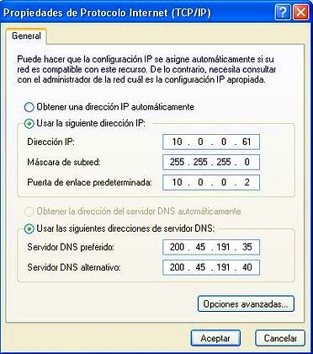
CLASES DE IP
1
Configuración TCP/IP
80%
20%
Clase A: 10.0.0.0/24 | Clase B: 172.16.0.0/16
www.treeknow.com

Slide 4
SERVIDORES DNS
2
Microempresas o WISP
MOVISTAR: 200.48.225.130 | 200.48.225.146
CLARO: 200.108.96.x | 200.108.96.x
ARNET: 200.45.191.35 | 200.45.48.293
TELEFONICA ESP: 80.58.61.250 | 80.58.61.254
TELMEX: 208.67.222.222 | 208.67.222.220
TELMEX COL: 200.118.2.91 | 200.118.2.66
www.treeknow.com

Slide 5
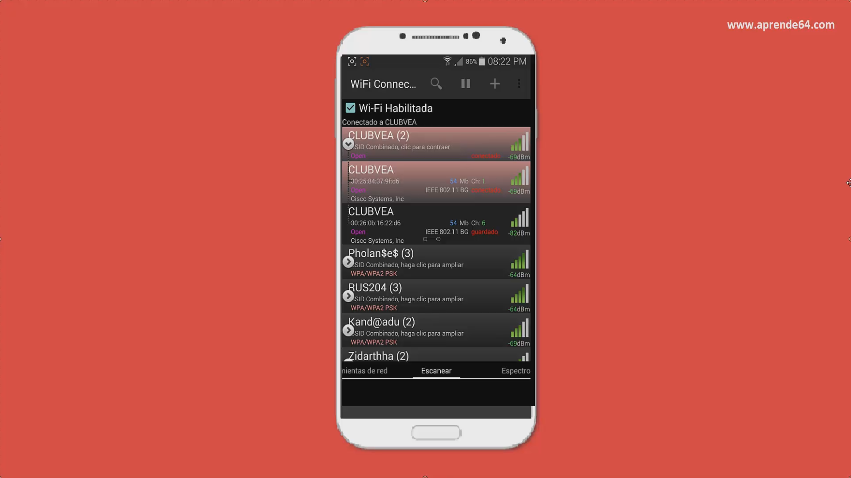
2
www.treeknow.com

Slide 6
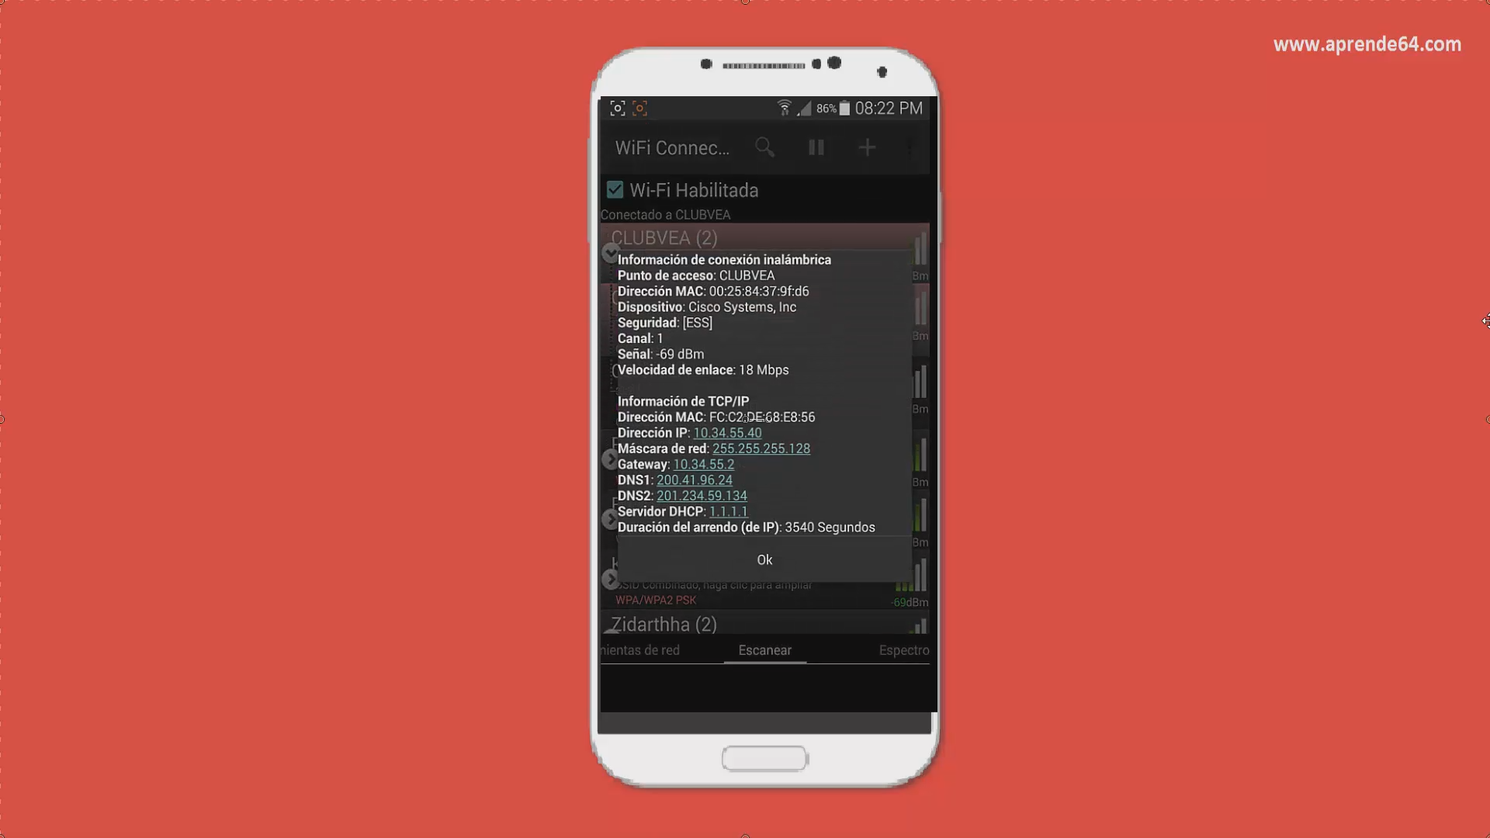
2
www.treeknow.com

Slide 7


SERVIDORES DNS
2
Empresas Corporativas
LEVEL3: 200.41.96.24 | 201.234.59.134
Servicio Público
Servicio Corporativo
www.treeknow.com

Slide 8

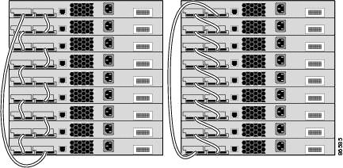
3
Tecnología
Routers & Switches CISCO
www.treeknow.com

Slide 9

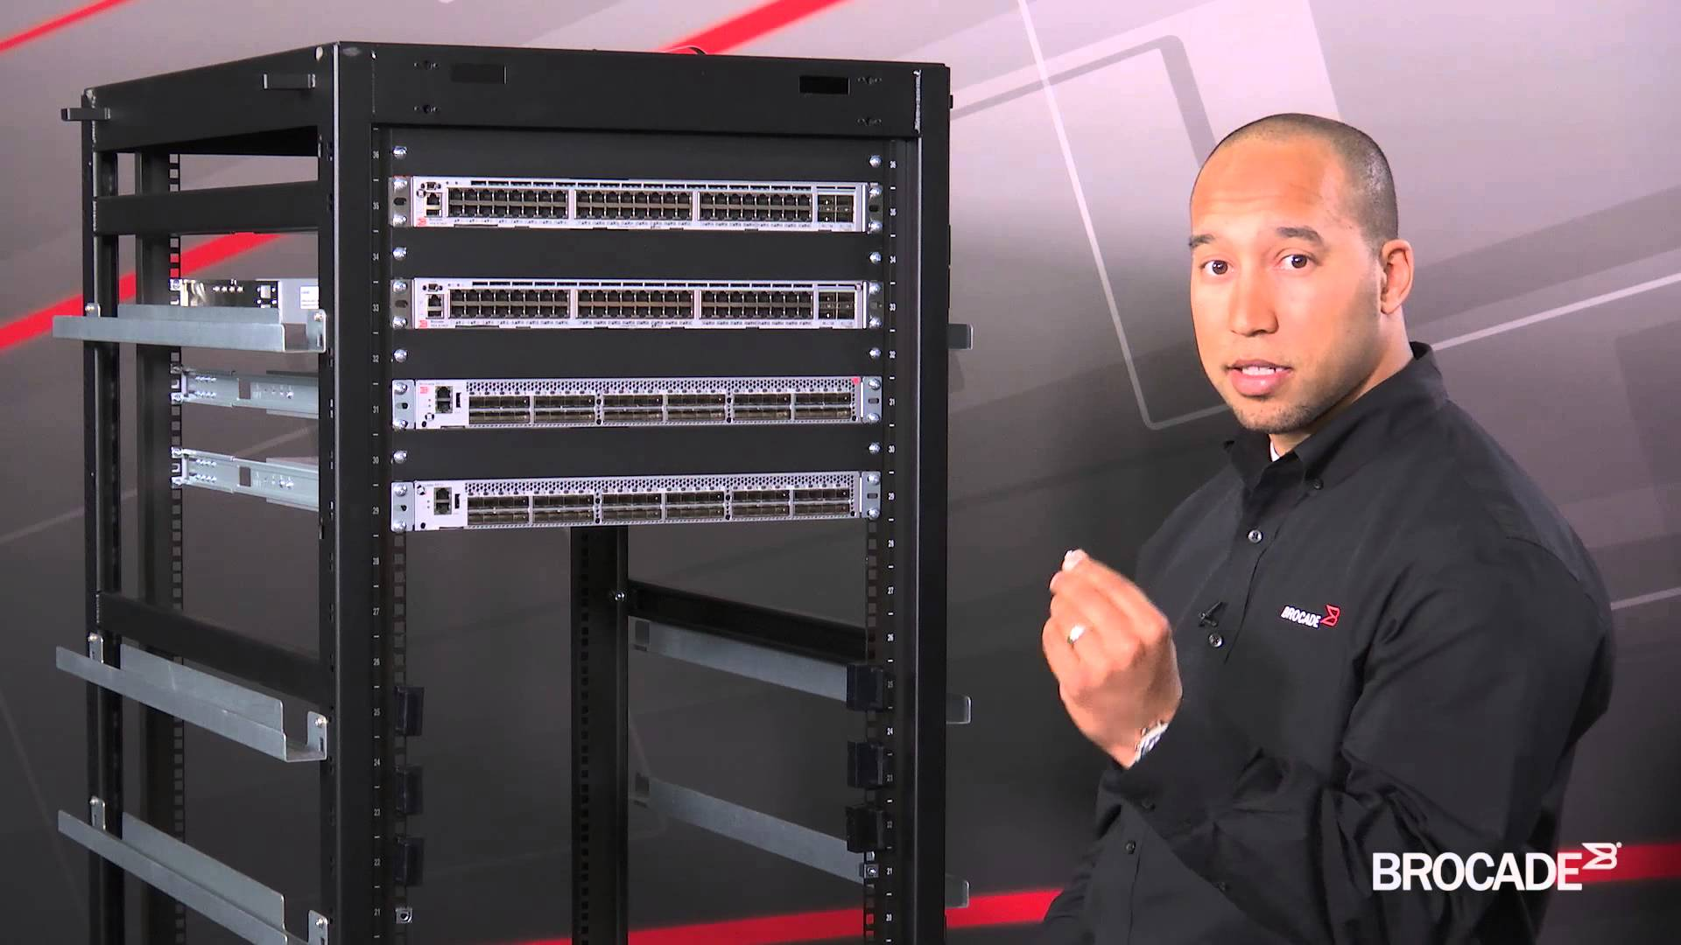
3
Brocade Systems
Routers & Switches BROCADE
www.treeknow.com

Slide 10





3
Tecnología
www.treeknow.com

Slide 11


SERVIDORES OS
3
Pentesting Externo
www.treeknow.com

Slide 12
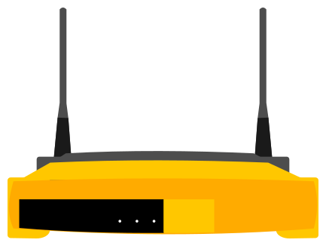
Enrutadores
3
Routers Microempresas
LINKSYS
NETGEAR
TRENDNET
ARCADYAN
No olvidar: Tp-link, D-Link.
www.treeknow.com

Slide 13

FABRICANTE
4
Fabricante
1. Existen herramientas que nos brindan esta información (Desktop y Móvil)
2. Fabricante = ¿Marca del Hardware?
¿Qué hardware?
www.treeknow.com

Slide 14

4
Intel Corporation
Mac Address
WINDOWS
LINUX
INTEL WIFI LINK
LENOVO
HP
LAPTOP
DELL
Hon Hai precision Ind. co. ltd
PC o Laptop
www.treeknow.com

Slide 15
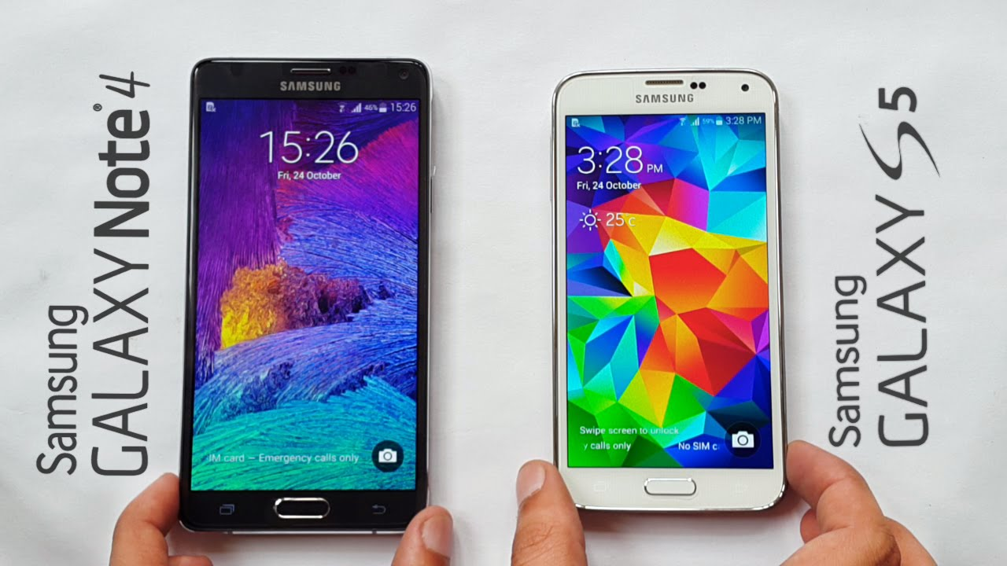
4
Mac Address
Murata Manufacturing Co. Ltd
www.treeknow.com

Slide 16
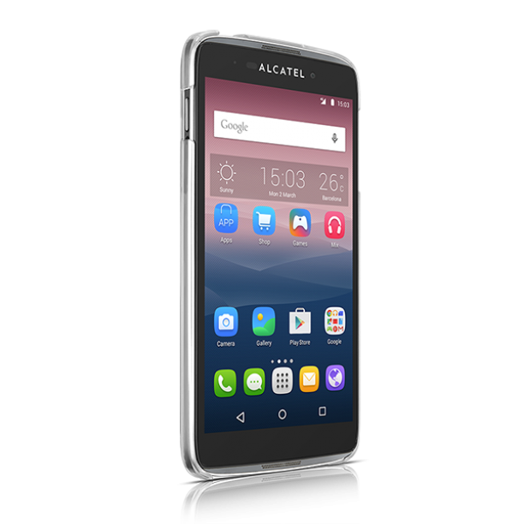
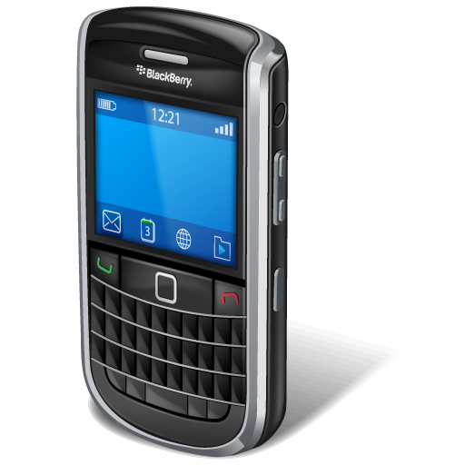
4
Mac Address
Research in Motion
TCT Mobile
BLACKBERRY OS
Android OS
www.treeknow.com

Slide 17


4
Mac Address
Apple ¿MacBook o Iphone?
www.treeknow.com

Slide 18
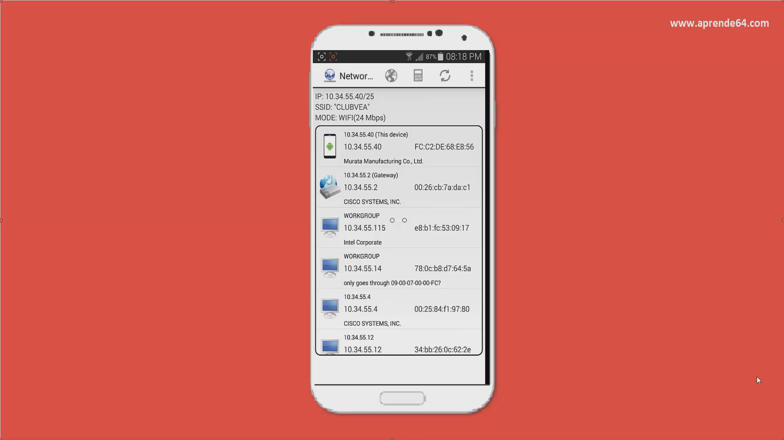
2
https://play.google.com/store/apps/details?id=com.myprog.netscan&hl=es
www.treeknow.com

Slide 19
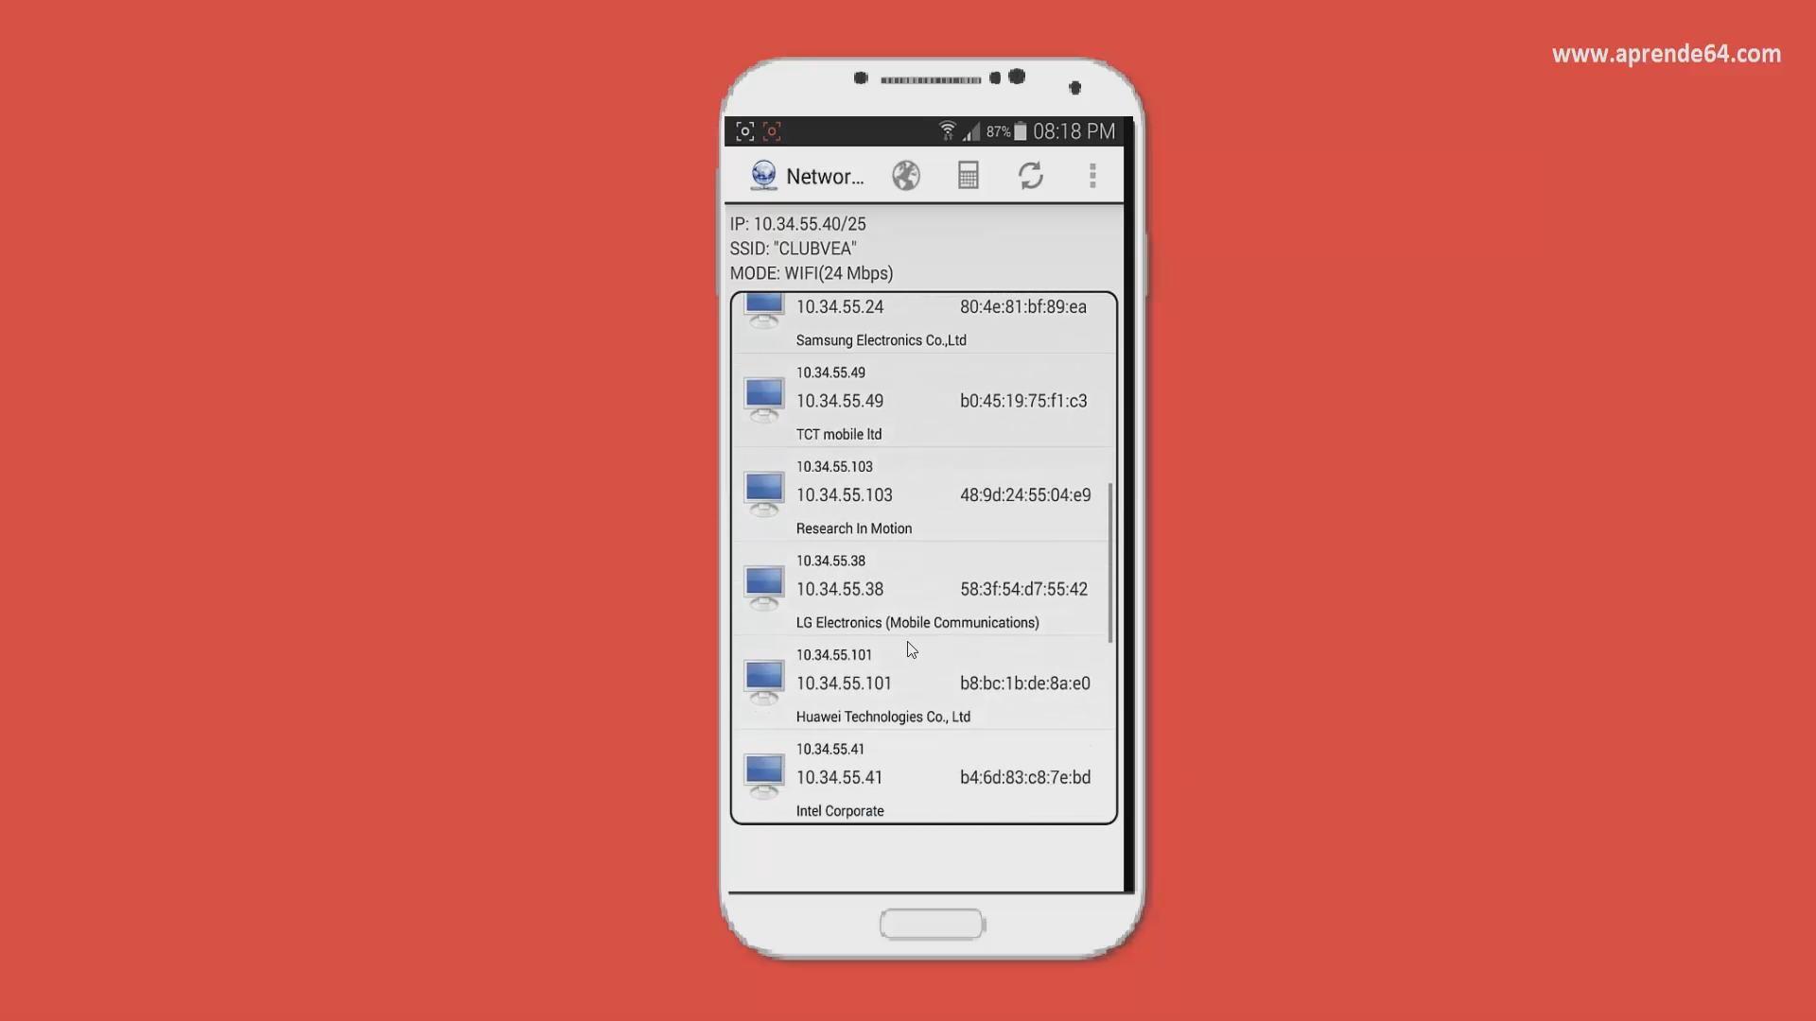
2
https://play.google.com/store/apps/details?id=com.myprog.netscan&hl=es
www.treeknow.com

Slide 20

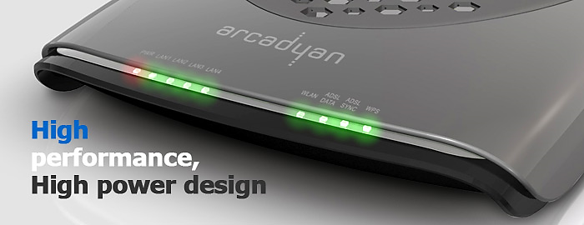
4
Mac Address
Arcadyan Technology Corporation
www.treeknow.com

Slide 21






Cámaras IP
4
Vigilancia
Cámaras independientes: TP-LINK, TRENDNET
www.treeknow.com

Slide 22





IMPRESORAS IP
4
Printers
www.treeknow.com

Slide 23
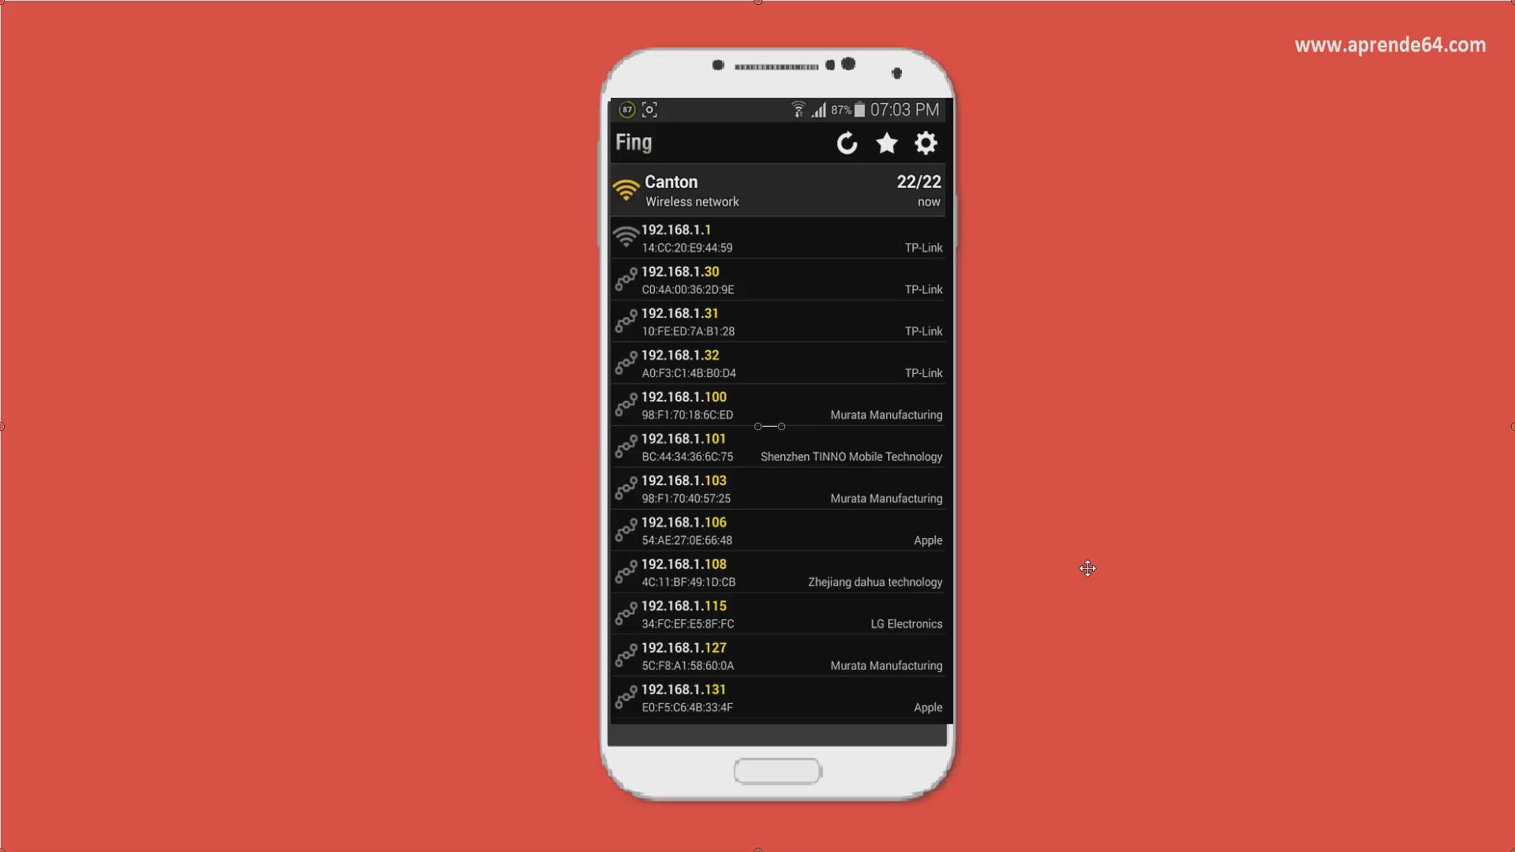
2
https://play.google.com/store/apps/details?id=com.overlook.android.fing&hl=es_419
www.treeknow.com

Slide 24
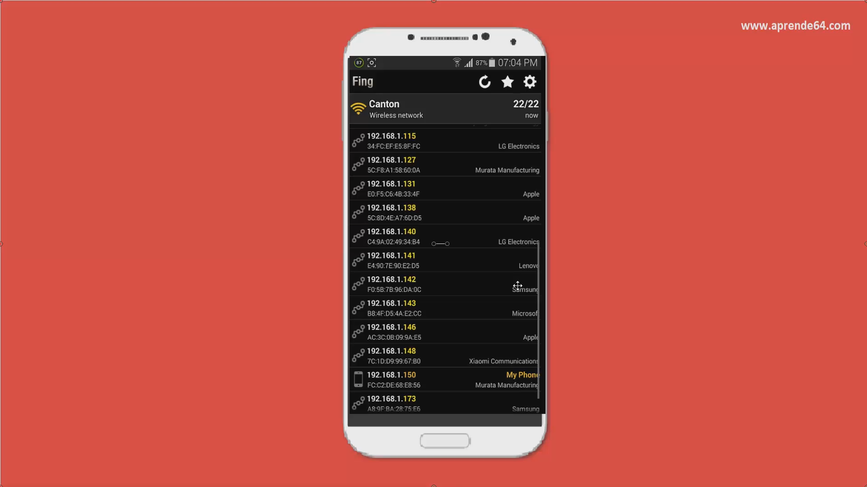
2
https://play.google.com/store/apps/details?id=com.overlook.android.fing&hl=es_419
www.treeknow.com

Slide 25
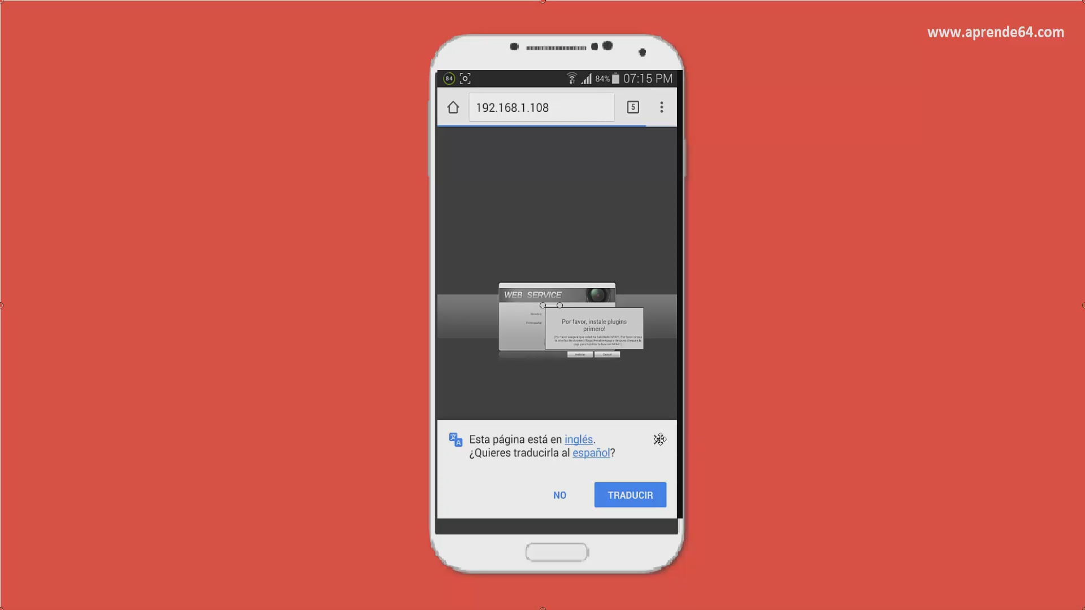
2
https://play.google.com/store/apps/details?id=com.mm.android.direct.gdmsspadLite&hl=es_419
www.treeknow.com

Slide 26
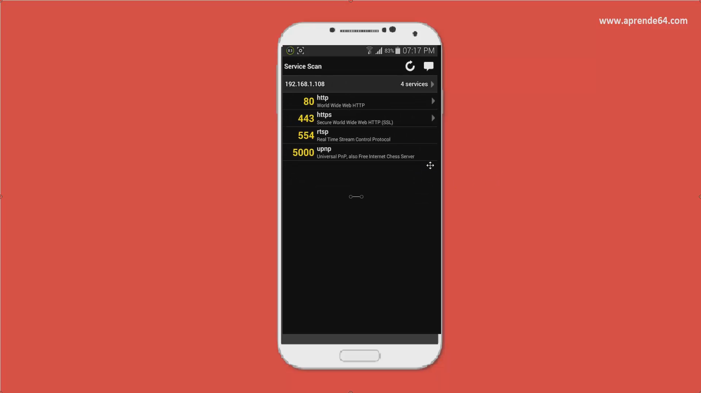
2
https://play.google.com/store/apps/details?id=com.overlook.android.fing&hl=es_419
www.treeknow.com

Slide 27
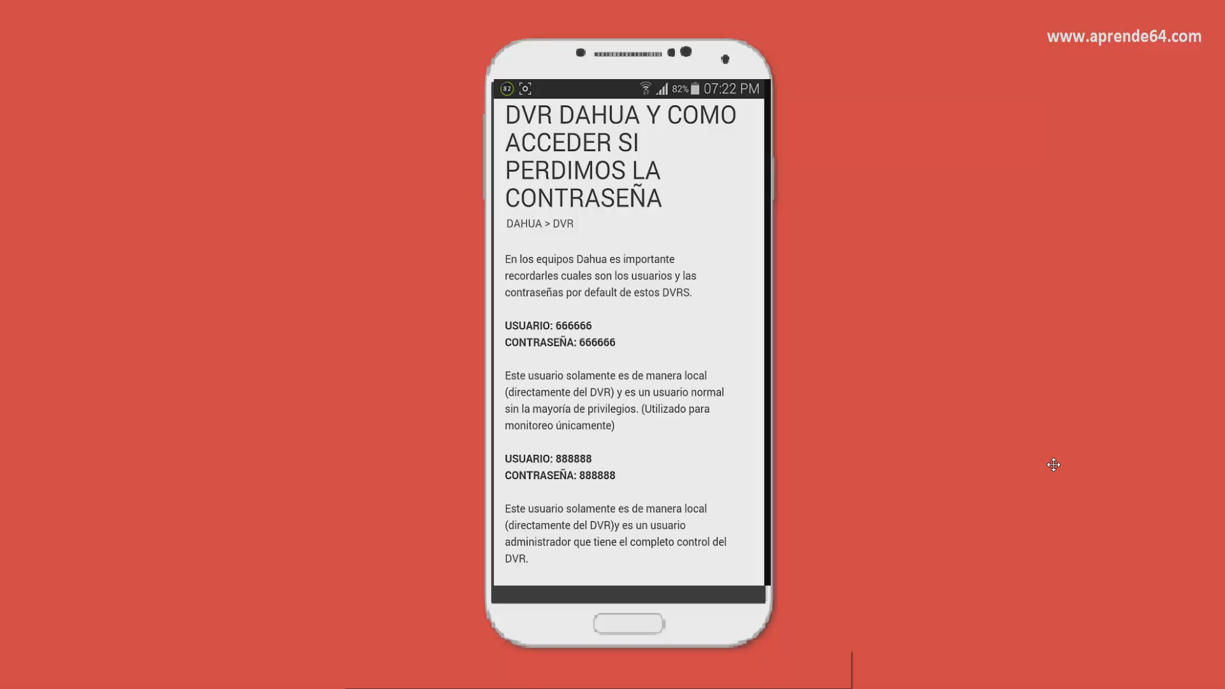
2
http://ingenieria.tvc.mx/kb/a582/usuarios-default-dvr-dahua-y-como-acceder-si-perdimos-la-contrasena.aspx
www.treeknow.com

Slide 28
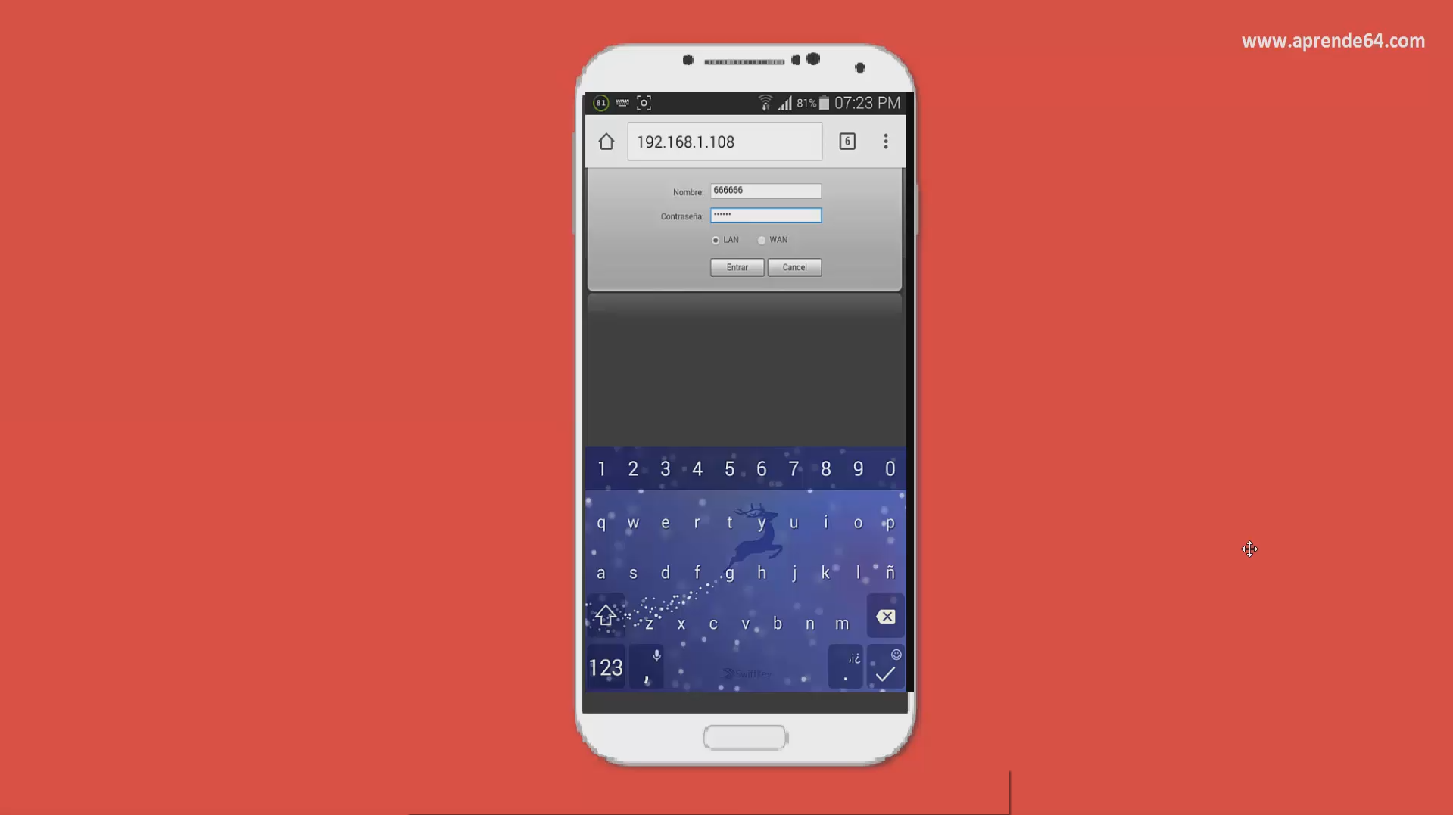
2
www.treeknow.com

Slide 29
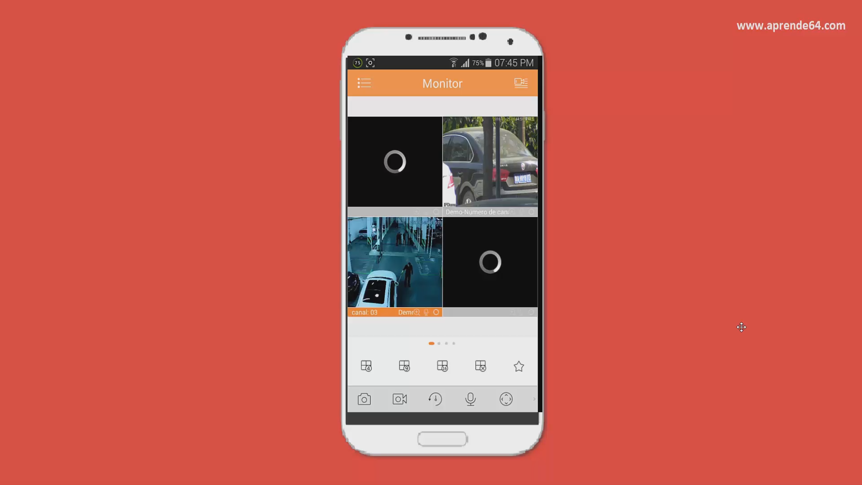
2
https://play.google.com/store/apps/details?id=com.mm.android.direct.gdmsspadLite&hl=es_419
www.treeknow.com

Slide 30
NIVEL I
PENTESTING EXTERNO
www.treeknow.com

Slide 31




LÓGICA
Black information
Information Gray
Information White
Reconstructed
www.treeknow.com

Slide 32
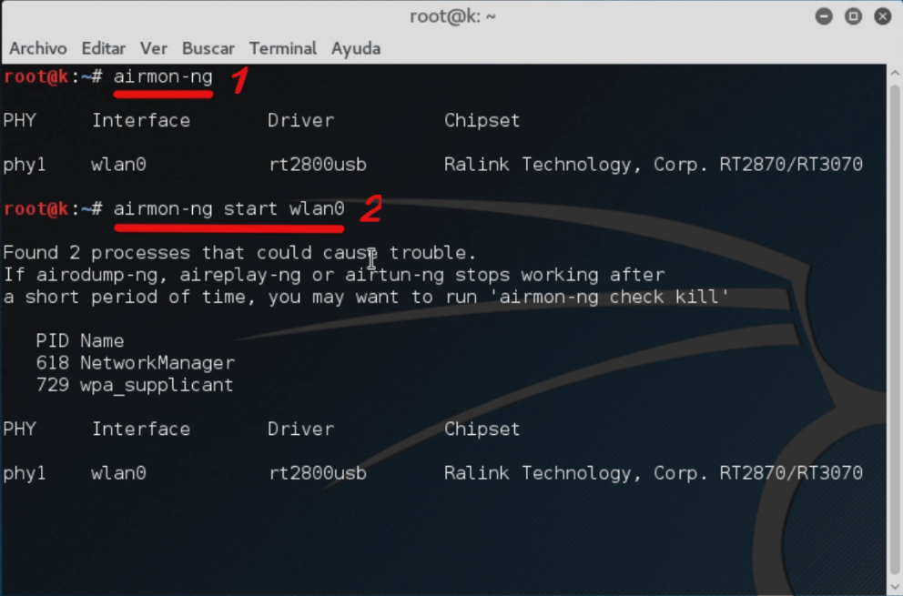
1
www.treeknow.com

Slide 33
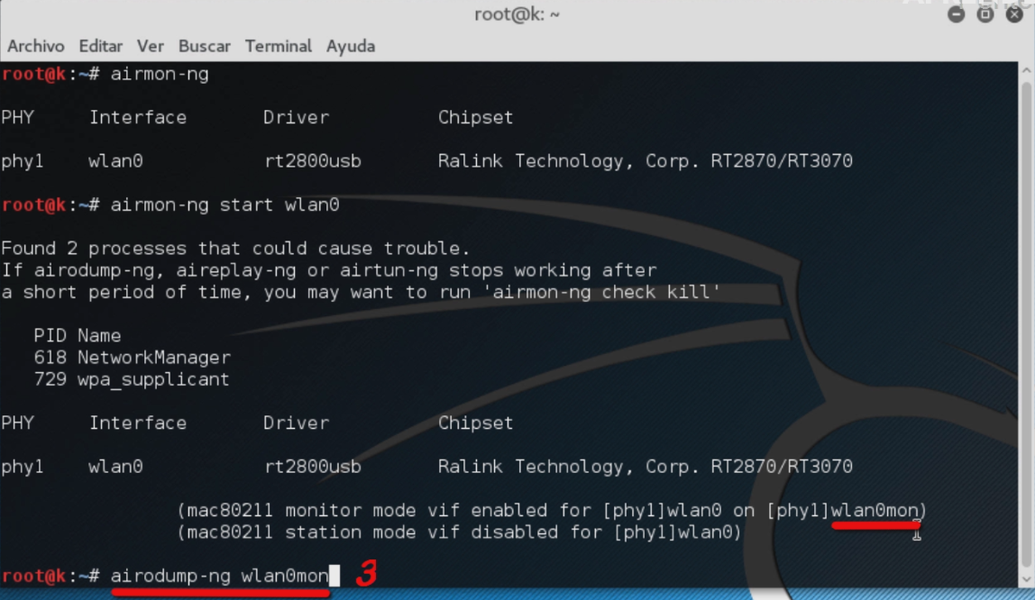
1
www.treeknow.com

Slide 34
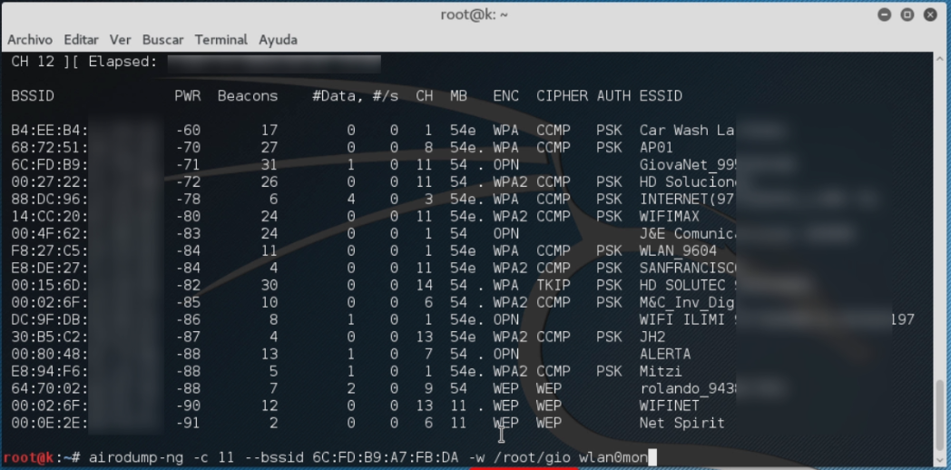
1
www.treeknow.com

Slide 35
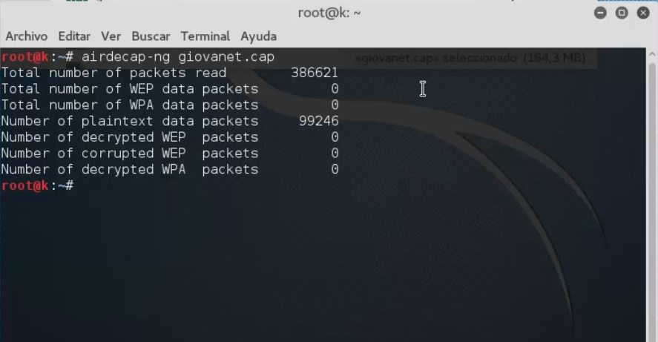
2
ENTERPRISE Red Abierta
Desencriptar con airdecap-ng
www.treeknow.com

Slide 36
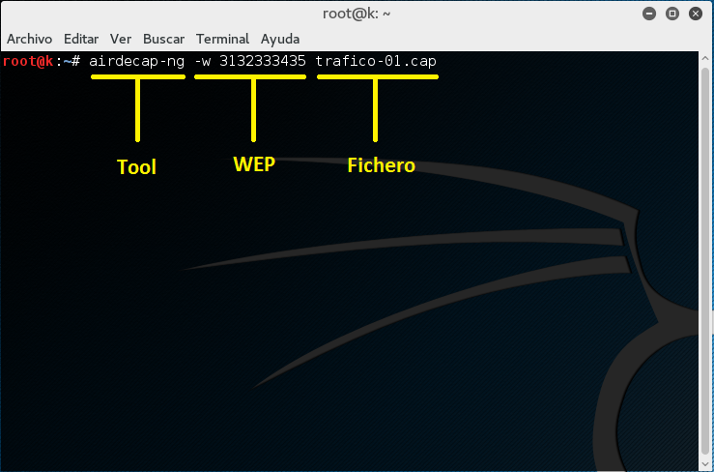
2
ENTERPRISE Seguridad WEP
Desencriptar con airdecap-ng
www.treeknow.com

Slide 37
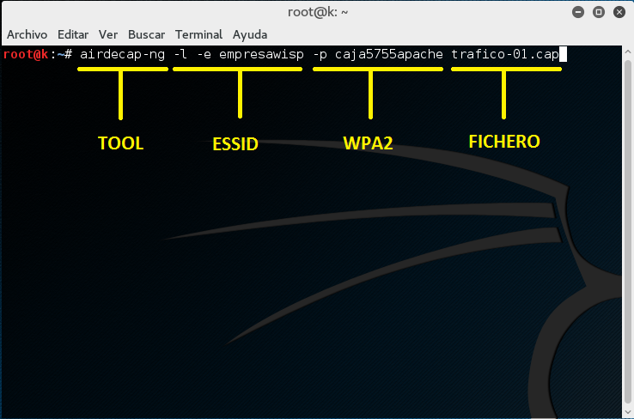
2
ENTERPRISE Seguridad WPA2
Desencriptar con airdecap-ng
Tener HandShake
www.treeknow.com

Slide 38
NIVEL II
FORENSICS
www.treeknow.com

Slide 39
NETWORK MINER
FORENSICS
https://www.netresec.com/?download=NetworkMiner
www.treeknow.com

Slide 40
NIVEL III
FORENSICS
www.treeknow.com

Slide 41
FOCA PRO
FORENSICS
https://www.elevenpaths.com/downloads/FocaPro.zip?agree=on
www.treeknow.com

Slide 42
https://www.thexifer.net/
FORENSICS
www.treeknow.com

